Slide 1

P.A.C.D Proficiency and Competence Driven
Maadd Slackers

Slide 2
Employee Training
74%
Of employees think they have a lot of untapped potential and want more training
89%
Of HR leaders agree that constant employee training is essential

Slide 3
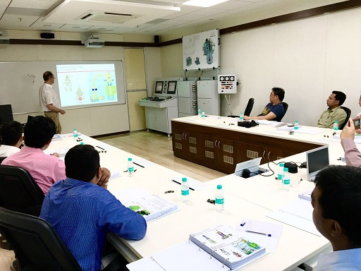


Gamification + Maritime

Slide 4



Problem
Trainers
Onboard & Onshore Staff
HR/Department Heads

Slide 5

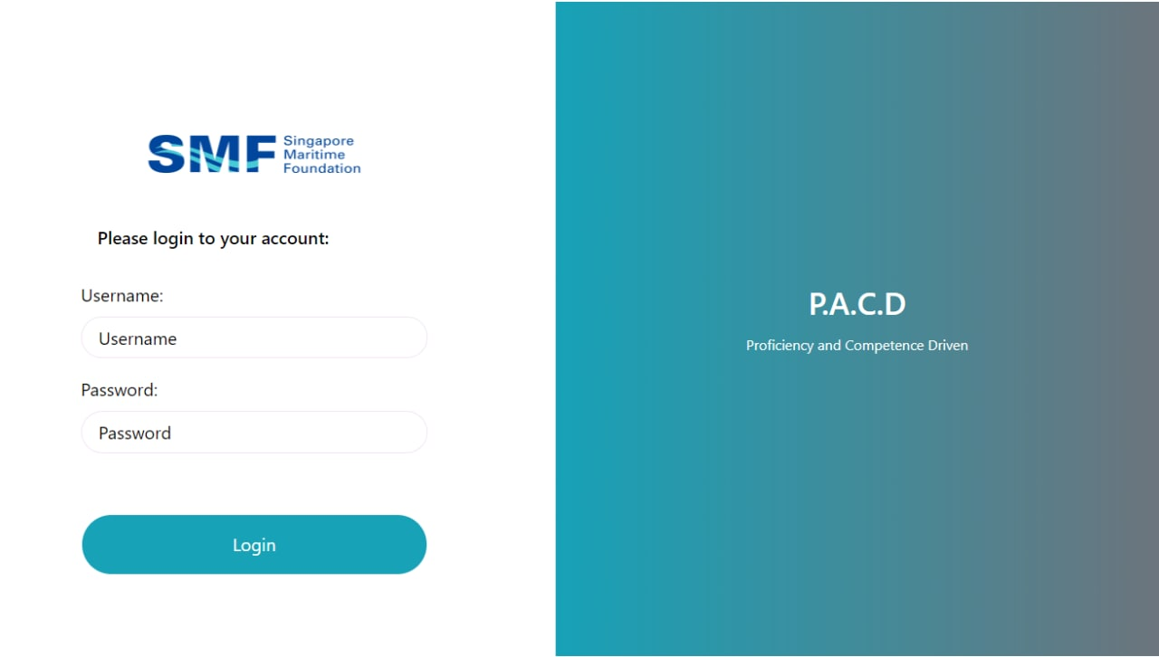
Introducing

Slide 6
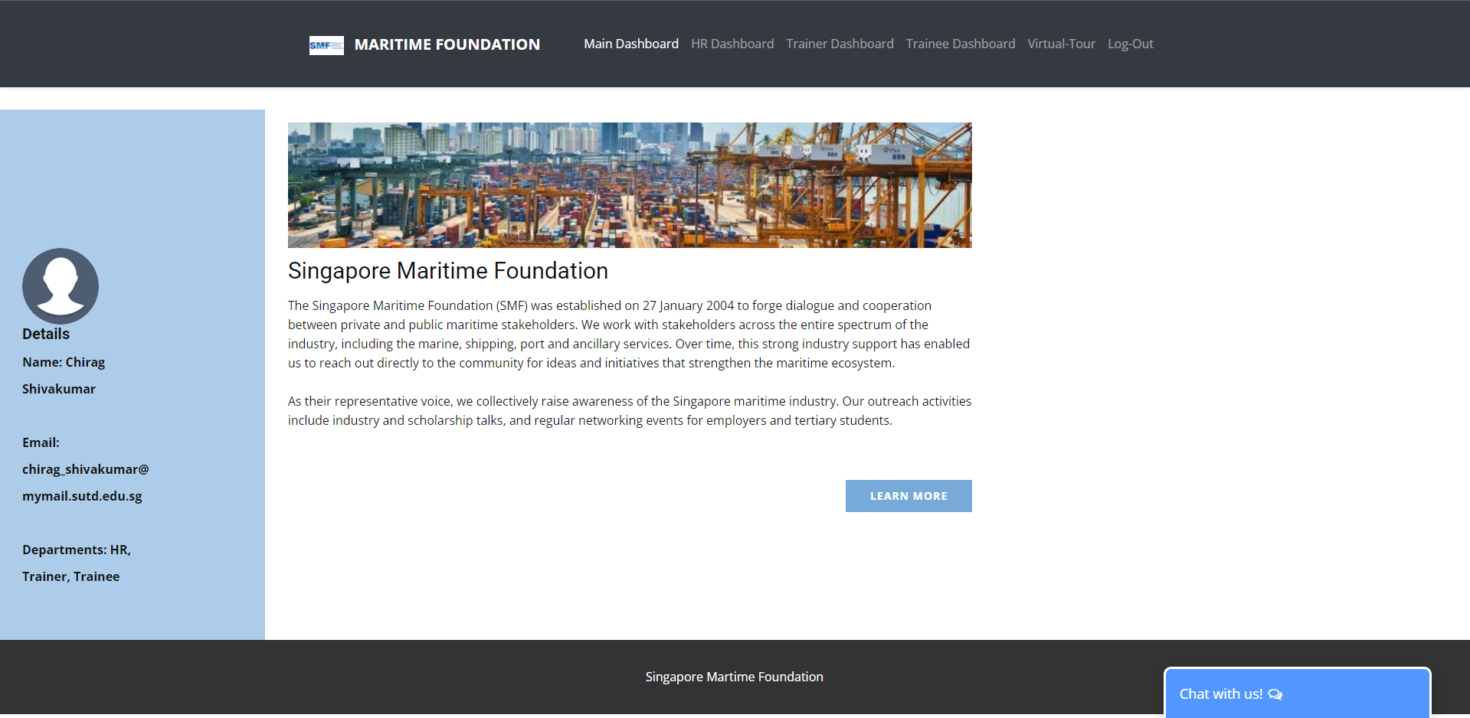
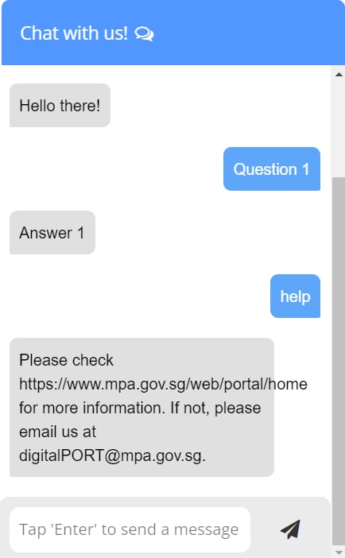
Main Dashboard

Slide 7
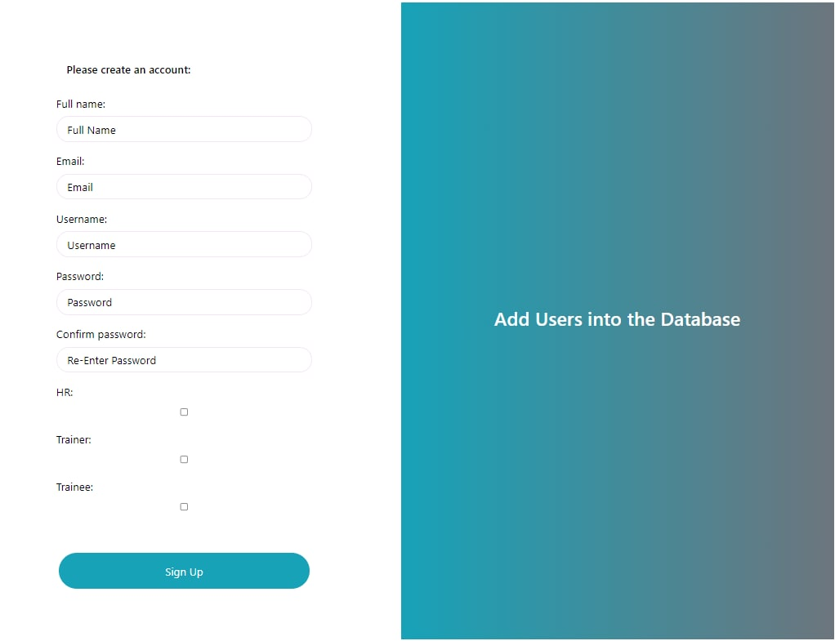
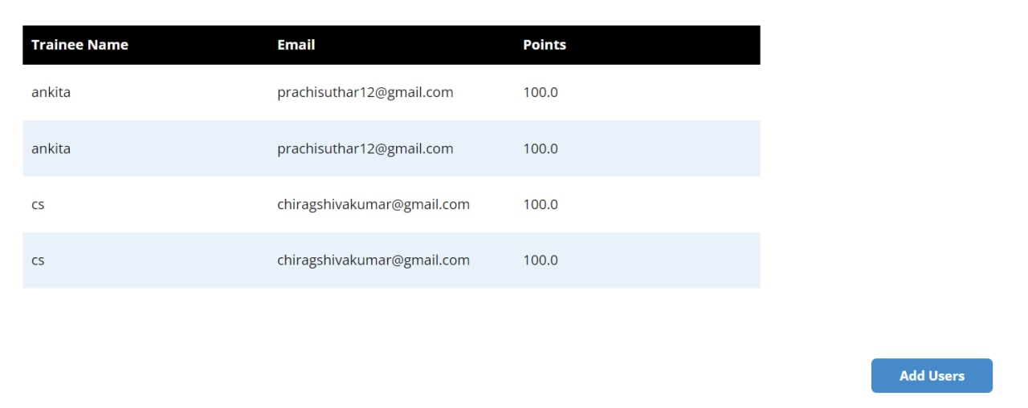
HR Dashboard

Slide 8
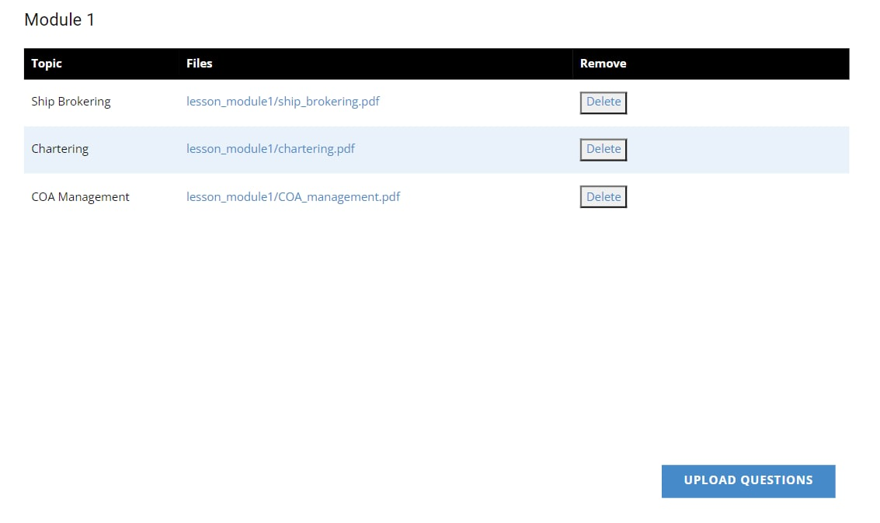
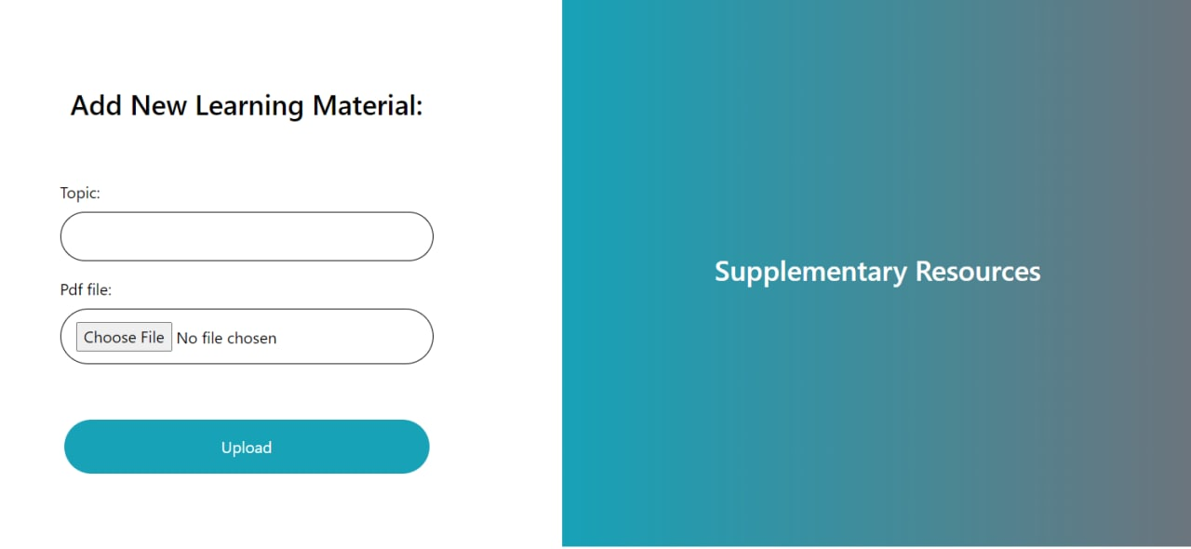
Trainer Dashboard

Slide 9
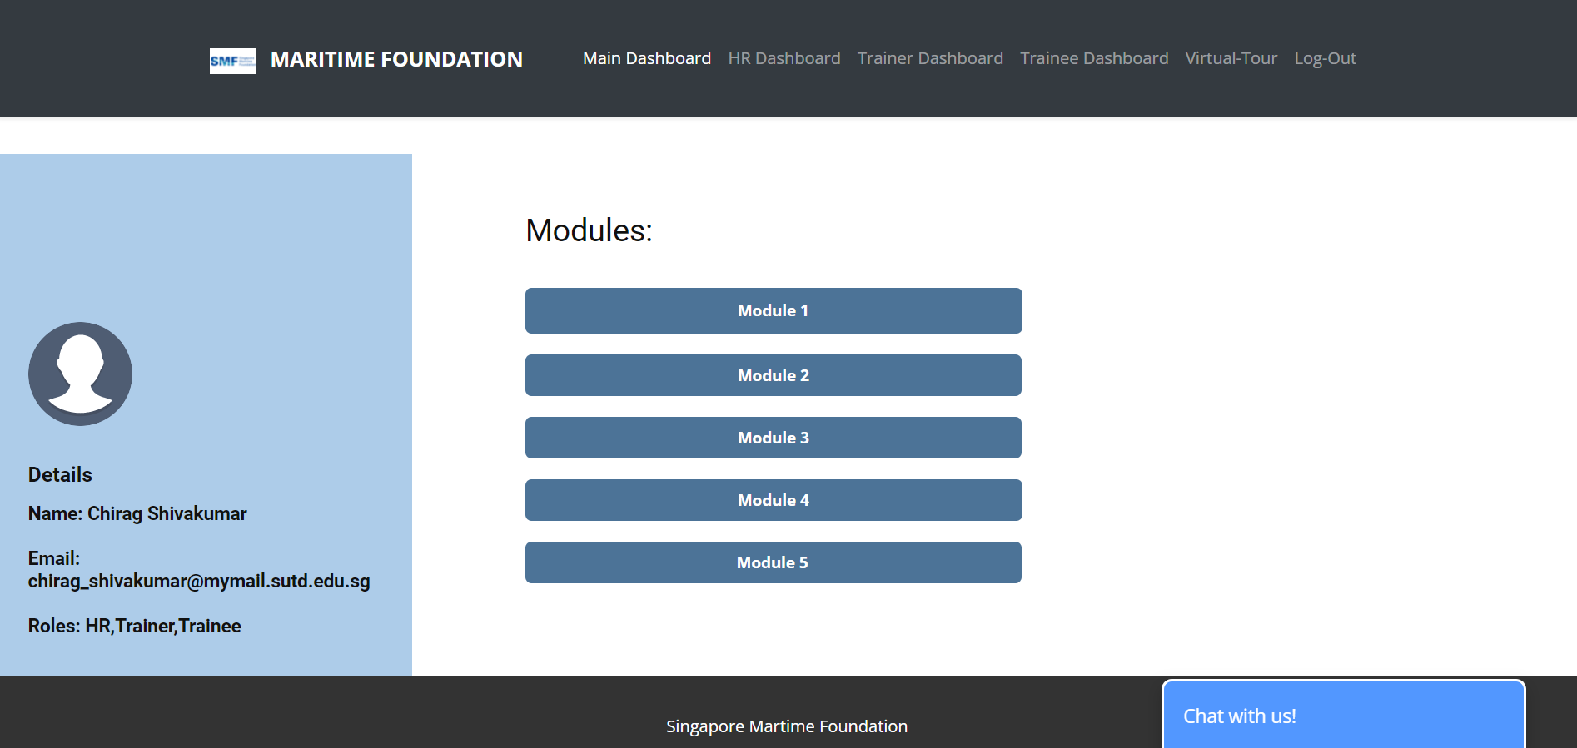
Trainee Dashboard

Slide 10
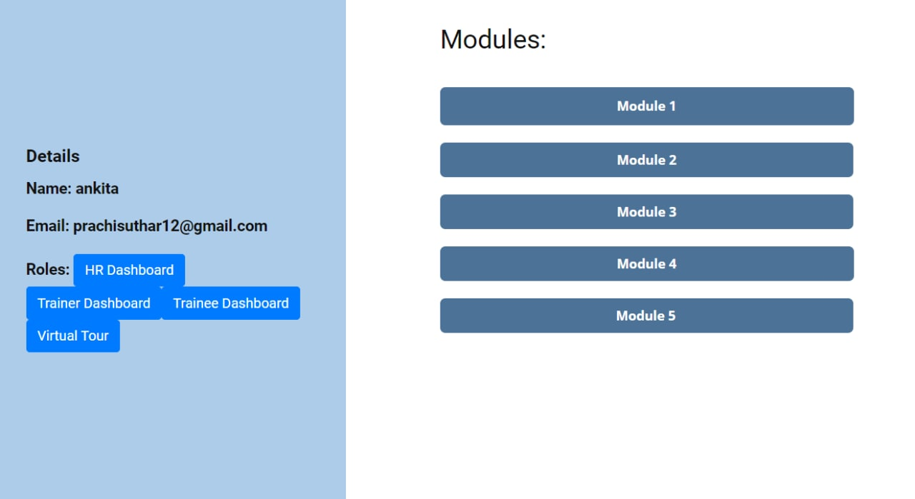
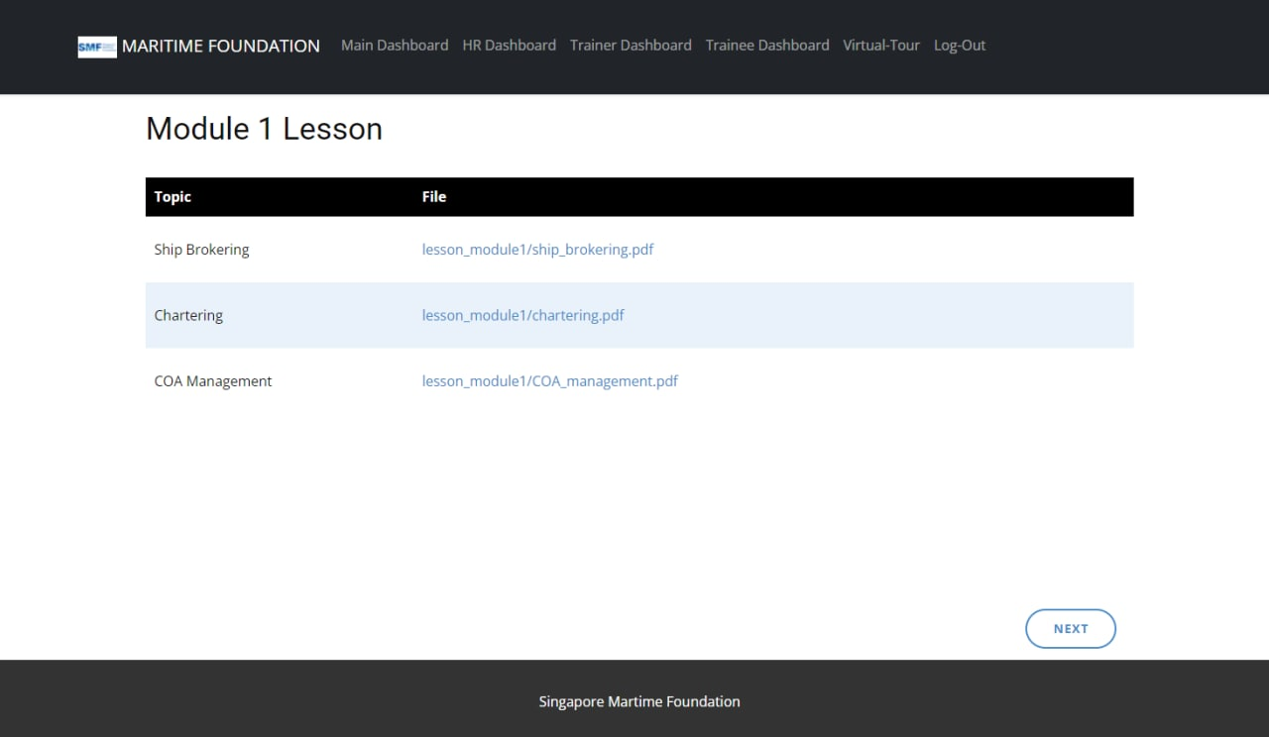
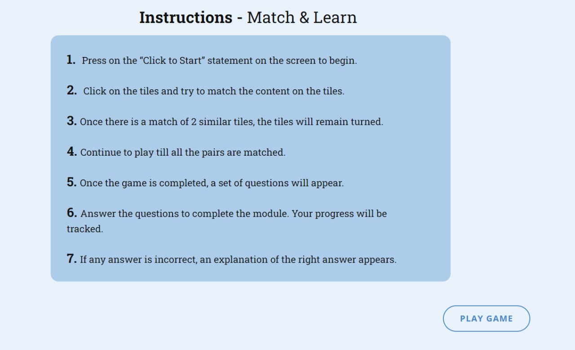

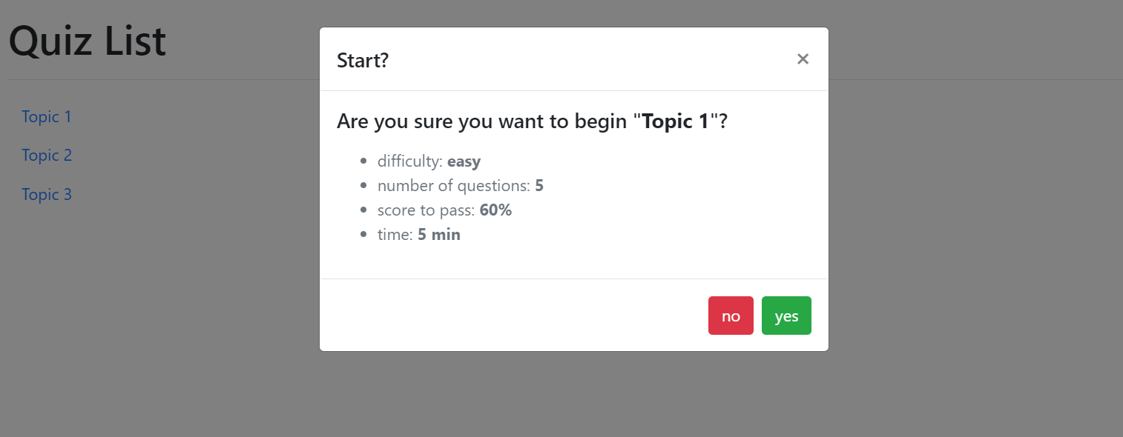
Module Flow

Slide 11
Game 1: Match and Learn

Slide 12

Game 2: Hangman

Slide 13
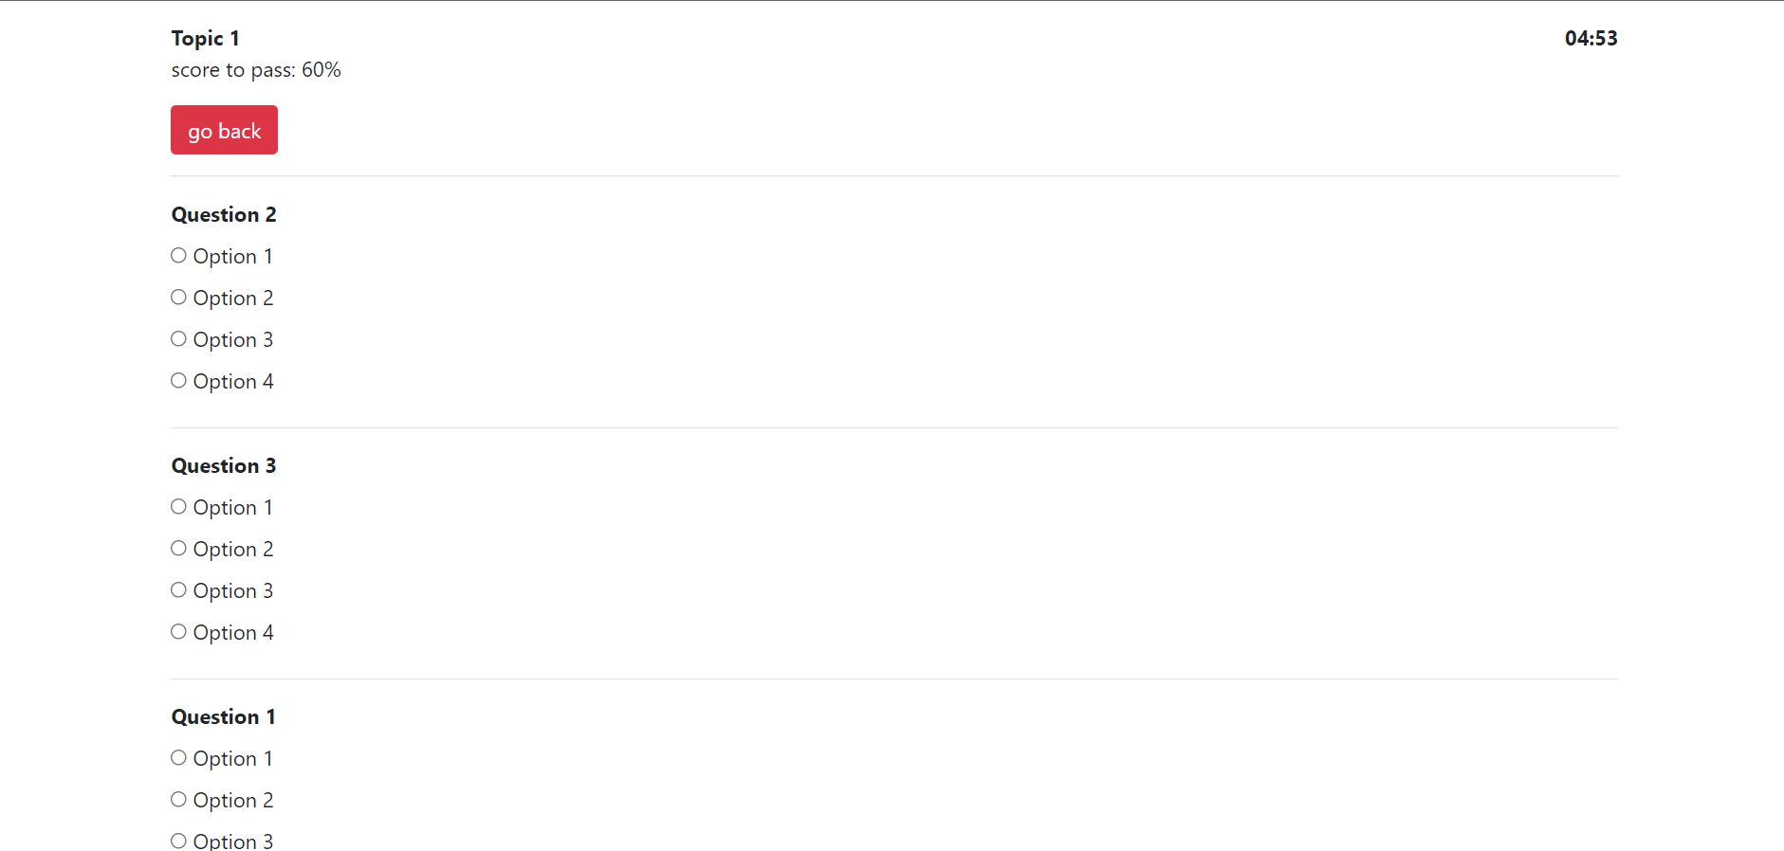
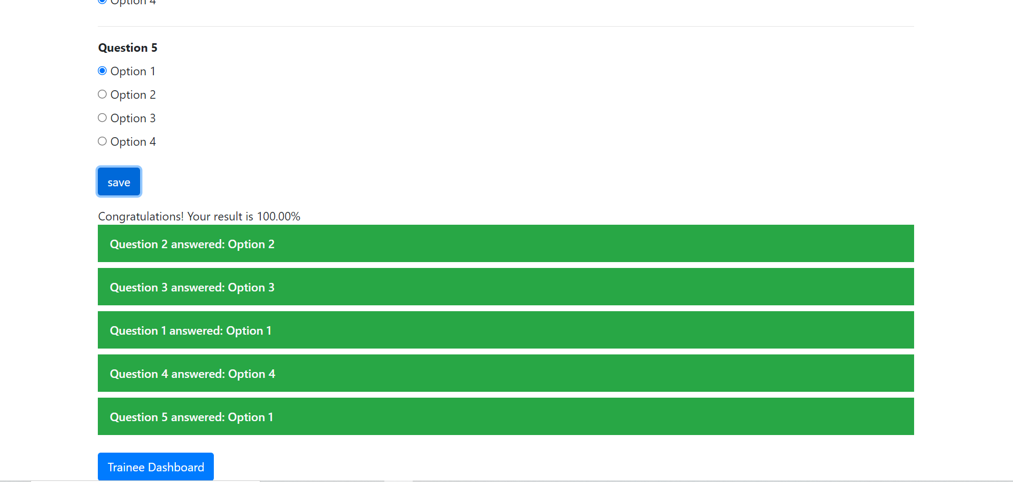
Quiz

Slide 14
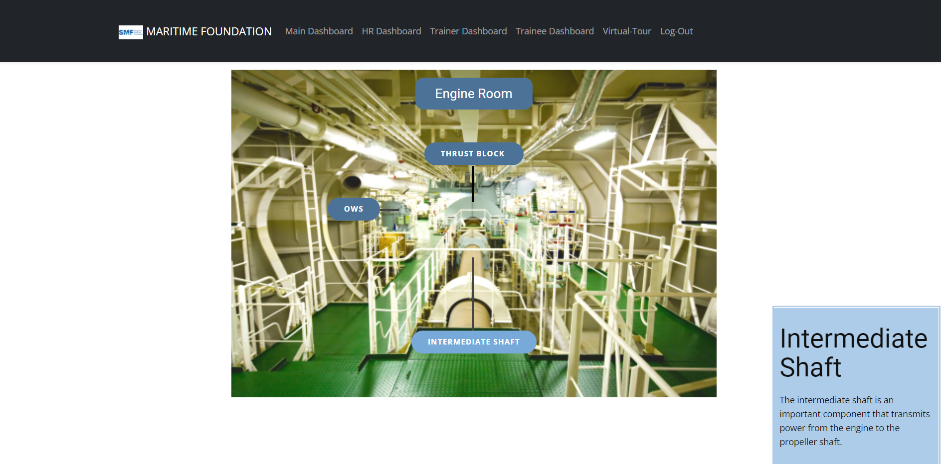
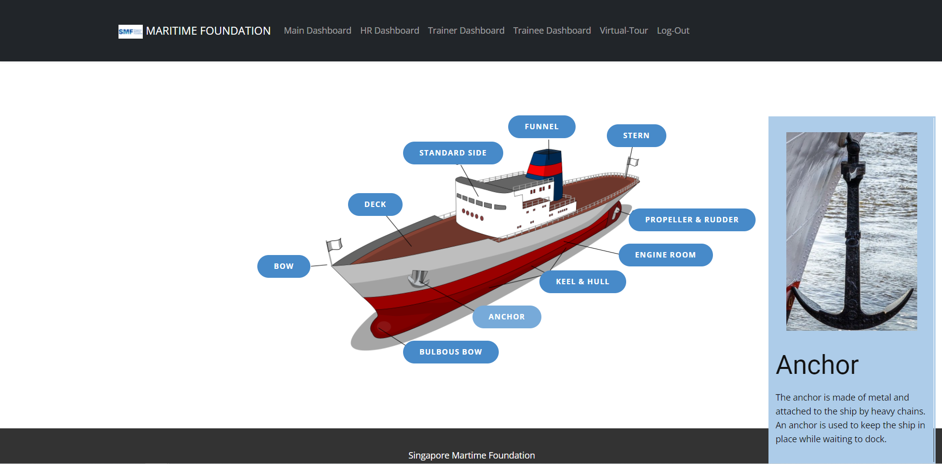
Virtual Tour

Slide 15
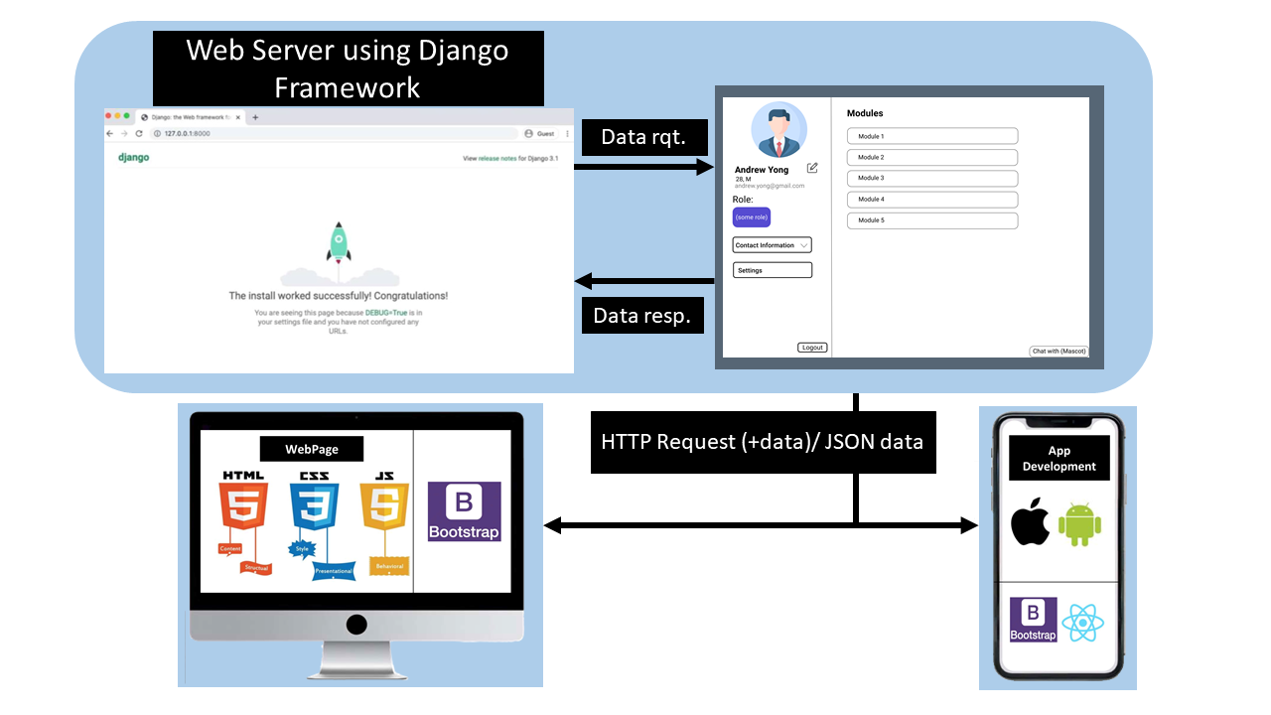
Technology Used
Framework : Django, Bootstrap
Languages: HTML, CSS, JavaScript, Python
Database: SQLite
Additional Software: Nicepage

Slide 16








Competitor Analysis
User Engagement
Quiz
Games
Learning
Ease of use
$$√$$
$$√$$
$$√$$
$$√$$
$$√$$
$$√$$
$$√$$
$$√$$
$$√$$
$$√$$
$$√$$
$$√$$
$$√$$
$$√$$
$$√$$
$$√$$
$$√$$
$$√$$

Slide 17
Expenses
 | Costs
Azure (Microsoft) to host server | < $15 /month per site for 1 GB = $180 /year
Hosting a large server | $55 /month = $660 /year for 10 GB
Maintenance of server - minor bugs in the website (WebBuddy) | $115 /month per website = $1380 /year
Total | $2220 /year approximate
WebBuddy: https://webbuddy.sg/pricing-plans/
Azure pricing: https://djangostars.com/blog/top-django-compatible-hosting-services/

Slide 18
WebsiteDemo

Slide 19
Thank you
Digitalization is the New cool P.A.C.D
Maadd Slackers
Notes:
Digitalization is the new cool

Slide 20
Citations/ References
1) Mirazoqui, S. (2020, July 28). Django: Top 9 reasons why you should use it. Asap Developers. https://www.asapdevelopers.com/django-reasons-why/
2) Singapore Maritime Foundation. (n.d.). Maritime Careers - SMF [Image]. https://www.google.com/imgres?imgurl=https%3A%2F%2Fwww.smf.com.sg%2Fwp-content%2Fuploads%2F2019%2F01%2F32-masthead-maritime-singapore-connect.jpg&imgrefurl=https%3A%2F%2Fwww.smf.com.sg%2Four-work%2Fmaritime-careers%2F&tbnid=c4wAXgR2BlFw9M&vet=12ahUKEwjGrqHiwPPyAhXCaCsKHYhPAUYQMygFegUIARDHAQ..i&docid=WjzKt-vFR809gM&w=1920&h=1080&q=maritime%20singapore&ved=2ahUKEwjGrqHiwPPyAhXCaCsKHYhPAUYQMygFegUIARDHAQ
3) https://djangostars.com/blog/top-django-compatible-hosting-services/
4) https://pixabay.com/photos/child-play-game-technology-3264751/
5) http://www.helixpr.asia/singapores-goodwood-ship-management-launches-new-training-center-office-mumbai/
6) https://www.piqsels.com/en/public-domain-photo-ojpbs
7) https://www.pngkit.com/view/u2w7t4r5e6q8u2e6_laptop-empty-macbook-pro-template-png/
8) https://leftronic.com/blog/employee-training-statistics/
9) https://www.makeuseof.com/duolingo-tips-language-learning/
10) https://www.businessinsider.com/coursera-plus

